Slide 1

Soft Systems Methodology
systems thinking systems
thinking systems thinking
systems thinking systems
thinking systems thinking

Slide 2
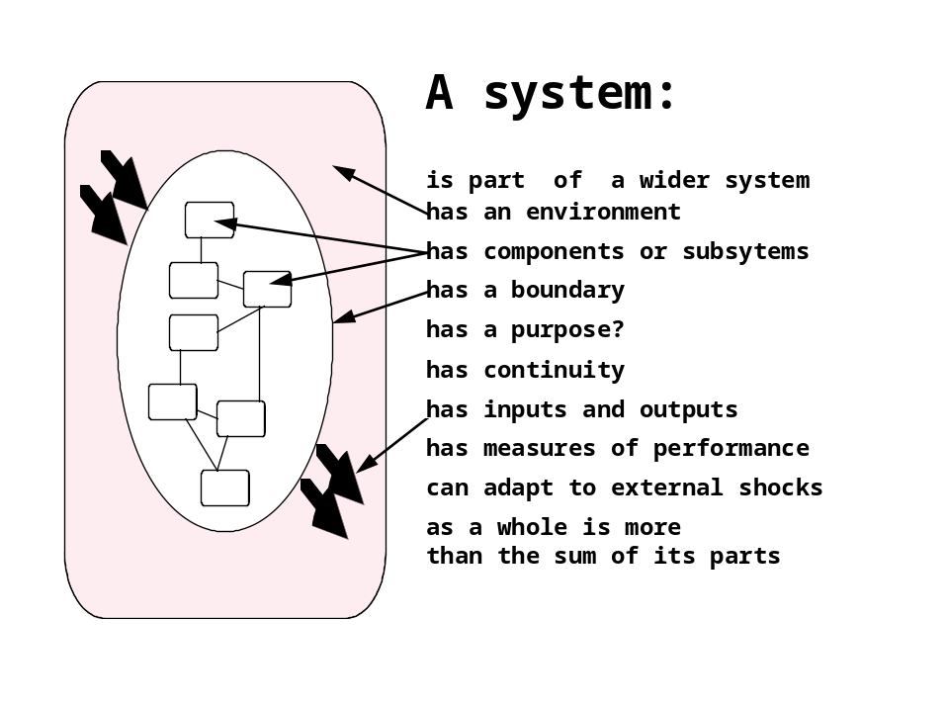
systems theory
a well-developed body of theoretical ideas - with many applications:
- systems analysis
- management
-engineering

Slide 3
hard systems thinking
hard systems approaches (systems analysis (structured methods), systems engineering, operations research) assume:
  objective reality of systems in the world
  well-defined problem to be solved
  technical factors foremost
  scientific approach to problem-solving
  one correct solution

Slide 4
soft systems thinking
soft systems approaches (Soft Systems Methodology, soft OR) assume:
  organisational problems are ‘messy’ (Ackoff), poorly defined
  stakeholders interpret problems differently (no objective reality)
  human factors important
  creative, intuitive approach to problem-solving
  outcomes are learning, better understanding, rather than a ‘solution’

Slide 5
methodology
in SSADM - rigid techniques and procedures to provide unambiguous solutions to well-defined data and processing problems problems, focused on computer implementations
in SSM - a loose framework of tools to be used at the discretion of the analyst, focused on improvements to organisational problems

Slide 6
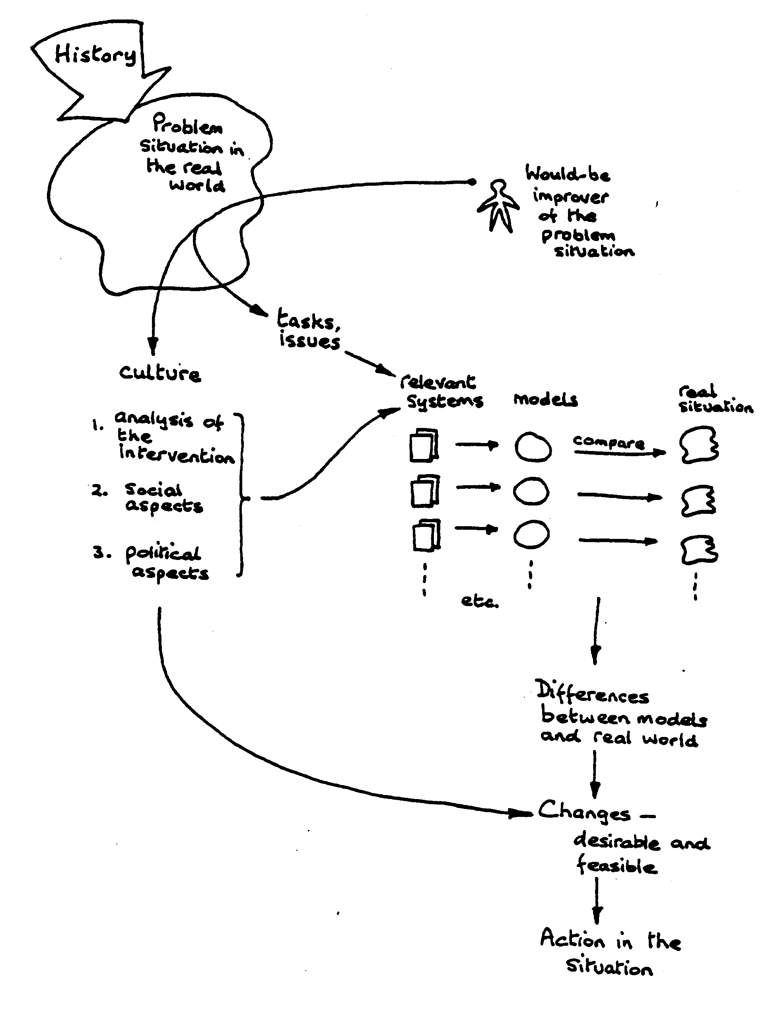
SSM
- the current picture:
- logic stream
- cultural stream
source: Checkland, SSM in Action

Slide 7
SSM – overview (seven stage model)
situation
considered
problematic
7 action to
improve the
problem situation
1
6 changes:
systemically desirable,
culturally feasible
problem
situation
expressed
comparison of
models and
real world 5
2
real world
systems thinking
about real world
3
root definition
of relevant systems
conceptual models
of systems described
in root definitions 4
source: Checkland: Systems Thinking, Systems Practice

Slide 8
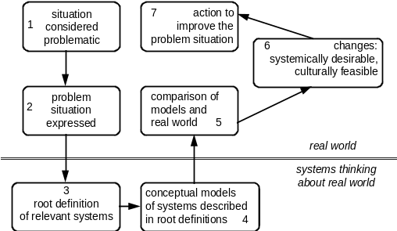
soft problems
perceived discomfort
poorly defined ‘mess’ (Ackoff)
human complications
unsuited to hard systems or OR techniques

Slide 9
rich pictures
observation
coffeetime yet?
boundary
idea!
crossed swords
=friction
iconic representations - drawn together into a picture which sums up the important elements of the problem situation

Slide 10
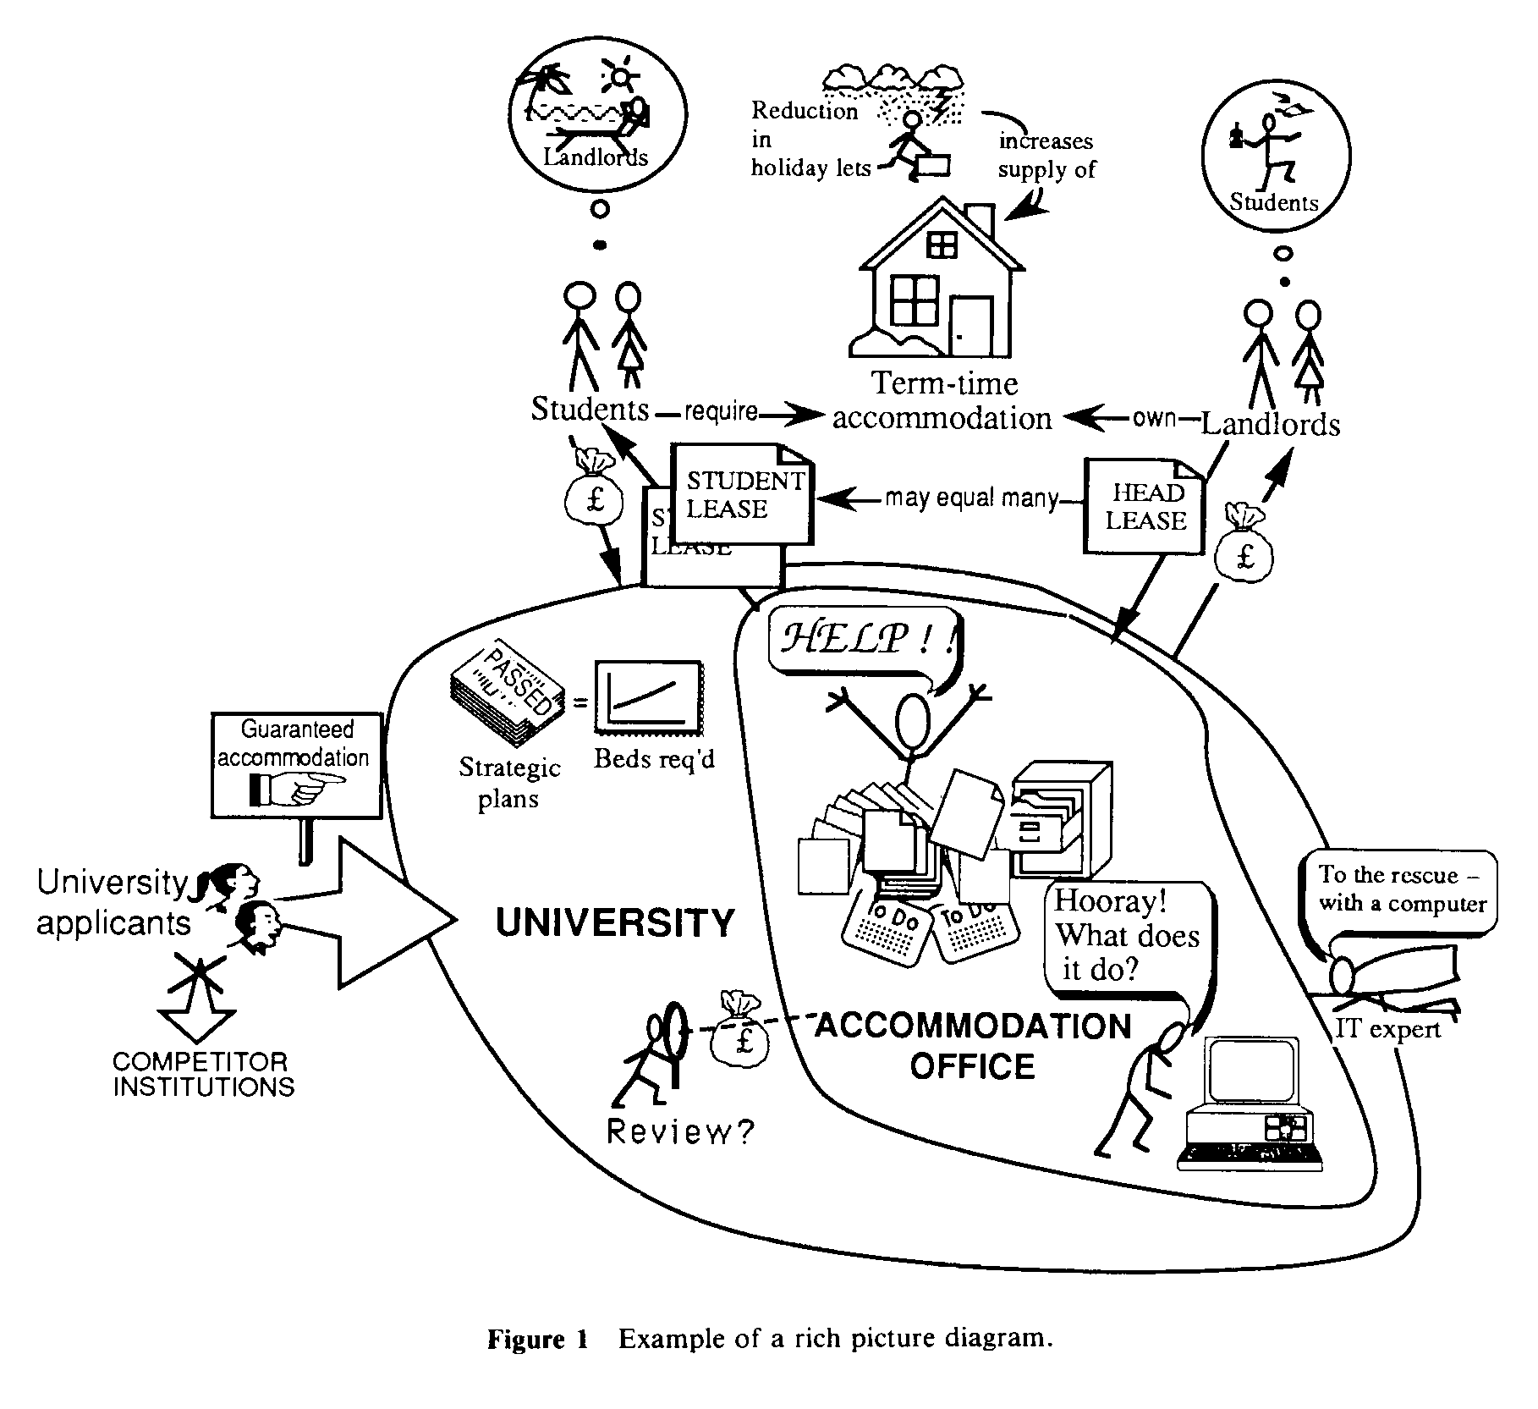
rich picture - example

Slide 11
deriving relevant systems
relevant systems are conceptual (in-the-mind) models of parts of the problem that are of interest
they are models which follow systems principles to help structure the analyst’s impression of the problem - not definitive descriptions of systems in the real world
problems can be represented as they are perceived by different stakeholders

Slide 12
root definitions
short textual statements which define the important elements of the relevant system being modelled - rather like mission statements
they follow the form:
a system to do X by (means of) Y in order to Z
what the system does - X
how it does it - Y
why it’s being done - Z

Slide 13
root definition examples
primary task (relating to basic tasks and structures)
A university owned and operated system to award degrees and diplomas to suitably qualified candidates (X), by means of suitable assessment (Y), (in conformance with national standards), in order to demonstrate the capabilities of candidates to potential employers (Z).
issue based (relating to temporary or qualitative concerns, or concerns of judgment)
A university owned and operated system to implement a quality service (X), by devising and operating procedures to delight its customers and control its suppliers (Y), in order to improve its educational products (Z).

Slide 14

CATWOE analysis a check to ensure that root definitions contain most of what is important
Customers the victims or beneficiaries of T
Actors those who do T
Transformation input output
Weltanschauung the worldview that makes the T meaningful in context
Owners those with the power to stop T
Environmental elements outside the system which
constraints are taken as given, but nevertheless
affect its behaviour

Slide 15
example CATWOE
C candidate students
A university staff
T candidate students
    degree holders and diplomates
W the belief that awarding degrees and diplomas is a good way of demonstrating the qualities of candidates to potential employers
O the University governing body
E national educational and assessment standards

Slide 16
activity (conceptual) models
representation of the minimum set of activities necessary to ‘do’ the root definition
activities modelled by verbs

Slide 17
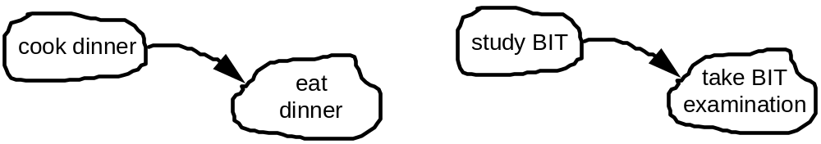
activity models - symbols
verb + noun
phrase
activity - ‘do something’
A
logical dependency arrow - activity A must come before B, or if activity A is done badly - so will B
B
boundary
example use

Slide 18
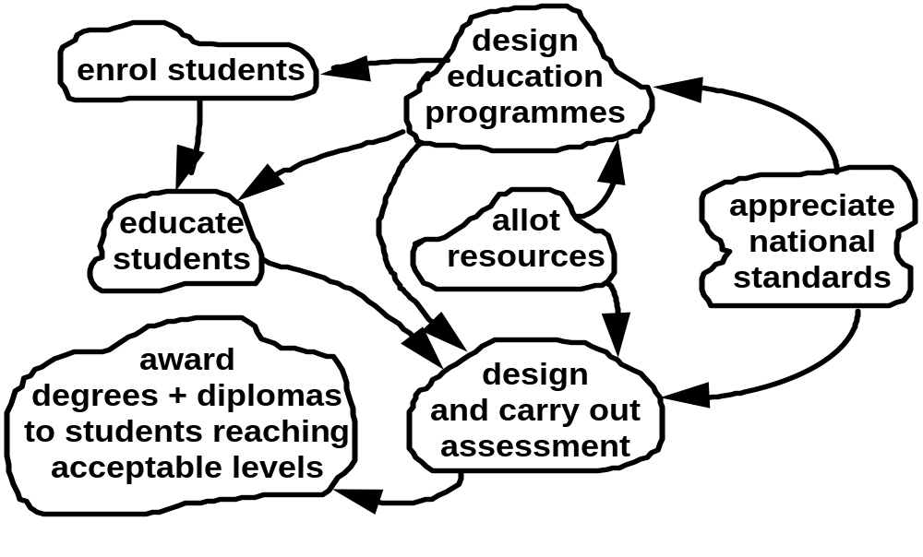
activity model - example
A university owned and operated system to award degrees and diplomas to suitably qualified candidates (X), by means of suitable assessment (Y), (in conformance with national standards), in order to demonstrate the capabilities of candidates to potential employers (Z).

Slide 19

measures of performance
E1 - efficacy (does the system work, is the transformation effected)?
E2 - efficiency (the relationship between the output achieved and the resources consumed to achieve it)
E3 - effectiveness (is the longer term goal (Z) achieved)

Slide 20

measures of performance - example
E1 (efficacy) - are degrees and diplomas awarded?
E2 (efficiency) - how many degrees and diplomas, of what standard, are awarded for the resource consumed?
E3 (effectiveness) - do employers find the degrees and diplomas a useful way of assessing the qualities of potential employees?

Slide 21
the complete conceptual model
root definition
CATWOE
activity model
measures of performance

Slide 22

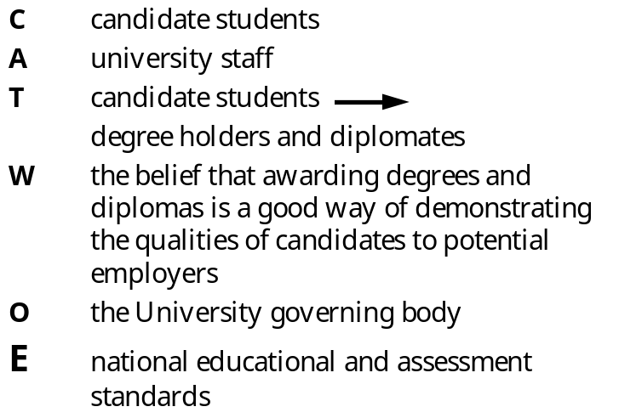
the complete model - example
design
education
programmes
enroll students
educate
students
allot
resources
appreciate
national
standards
award
degrees + diplomas
to students reaching
acceptable levels
design
and carry out
assessment
take control
action
monitor for
E1, E2, E3
E1 (efficacy) - are degrees and diplomas awarded?
E2 (efficiency) - how many degrees and diplomas, of what standard, are awarded for the resource consumed?
E3 (effectiveness) - do employers find the degrees and diplomas a useful way of assessing the qualities of potential employees?

Slide 23
levels of resolution
each activity may be modelled at a higher level of resolution - in other words a new root definition is prepared specific to that activity and a conceptual model built which further defines the set of (more detailed) activities necessary to accomplish it.
in this way complex situations with many activities can be modelled without loosing a sense of the overall shape of the problem

Slide 24
comparison with the real world
activity
is it done in the real situation?
how is it done?
comments,
recommendations
1
2
3

